Slide 1
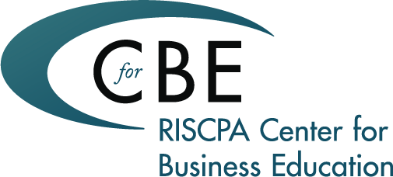
BETWEEN THE LEGAL LINES: Trending Topics at the Intersection of Business and Law
Tuesday, January 27th 8:30 to noon

Slide 2
PLAN FOR TODAY
NON-COMPETITION, NON-SOLICITATION, CONFIDENTIALITY & WORK-FOR-HIRE AGREEMENTS by Roger Hood
Some employment contracts contain clauses that restrict an employee's actions both during and after the period of employment. These clauses safeguard the employer's business interests and commonly include agreements on non-solicitation, non-competition, confidentiality and work-for-hire. Given the ever-changing legal landscape of employment law, it can be a formidable challenge to stay abreast of "best practices" and ongoing legislation. This program will address -- from a management view -- the purposes of and differences between the agreements.
BYOD, SOCIAL MEDIA & PRIVACY by Rachelle Green
In blurring the line between our professional and personal lives, the prevalence of social media and the trend toward BYOD (Bring Your Own Device) often prompt businesses to implement programs and policies governing employee behavior, … which may create a conundrum around data retention, the security of confidential information, wage-and-hour implications and privacy. Implemented properly, these policies can improve employee morale and convenience, reduce business costs, and boost productivity and revenue. Review the laws and regulations that impact social media, BYOD policies, and privacy of communications, and highlight relevant considerations.
BASICS OF BUSINESS LAW by Joshua Celeste
Whether you are forming or selecting a type of entity for your company; determining the optimal strategy and step-by-step roadmap for your next business deal; or planning ahead for the tax implications and liabilities related to your organization, knowing the legal nuances behind transactional structures is critical to business planning. Review best-practices and common pitfalls in running, managing and growing a business.

Slide 3
NON-COMPETITION, NON-SOLICITATION, CONFIDENTIALITY & WORK-FOR-HIRE AGREEMENTS by Roger Hood
rhood@DuffySweeney.com

Slide 4
NON-COMPETITION
Astro-Med, Inc. v. Nihon Kohden America, Inc. & Kevin Plant
U.S. Court of Appeals, First Circuit
October 22, 2009

Slide 5
NON-COMPETITION
In Rhode Island, non-competes must satisfy four general requirements to be enforceable:
Ancillary to an otherwise valid transaction or business relationship.
Supported by consideration (something of value).
Protect a legitimate business interest.
Must be both temporally and geographically reasonable.

Slide 6
NON-COMPETITION TAKEAWAYS
Limit use of non-competes to select positions
Time constraints – > 1 year may not be enforceable
Tailor geographic scope carefully
Consideration – continued employment probably enough – but not decided

Slide 7
NON-SOLICITATION
Prevents former employees from soliciting (i) other employees, or (ii) customers of former business
RI courts use “reasonableness” test

Slide 8
CONFIDENTIALITY
Confidential Information
Not in public domain
Information developed or compiled by investment of time & resources
Information that derives value from not being generally known
Non-Confidential Information
Information is publicly known
Information can be derived from public sources without great effort
Information disclosed to third parties not under a duty to maintain confidentiality

Slide 9
CONFIDENTIALITY TAKEAWAYS
Disclose only on as-needed basis
All disclosures to third parties subject to NDAs
Periodically remind employees of confidentiality obligations
Adopt and enforce confidentiality agreements and policies
Printed copies clearly marked “confidential”
Confidential information password-protected

Slide 10
WORK-FOR-HIRE
What does “work for hire” mean?

Slide 11
WORK-FOR-HIRE
Prepared by employee within scope of employment
OR
One of nine specified categories IF the parties expressly agree in writing

Slide 12
WORK-FOR-HIRE
Collective works
Motion picture or A/V work
Translation
Supplementary work
Compilation
Instructional text
A test
Answer material for a test
An atlas

Slide 13
WORK-FOR-HIRE
Why is this important?

Slide 14
WORK-FOR-HIRE
Ownership rights
Infringement rights
Registration rights
Distribution rights
Renewal rights
Protection in U.S. for 120 years after creation

Slide 15
WORK-FOR-HIRE
Employee v. Independent Contractor

Slide 16
WORK-FOR-HIRE
For Independent Contractors:
Written agreement – CRITICAL
and
Assignment of rights, including copyrights
Otherwise -- no Work for Hire

Slide 17
TAKEAWAYS
Employees need to sign Agreement on Inventions and Confidential Information.
Independent contractors and developers need to sign written agreement for services.
All contracts with contractors and developers need to address ownership rights and use of deliverables.

Slide 18
READING + REFERENCES
“OSHA Expanding Reporting & Exemptions”
By Roger Hood
Duffy & Sweeney BLOG (September 2014)
“Employment Law Nightmare: Intersection of ADA & FMLA”
By Roger Hood and Rachelle Green
Rhode Island Bar Association Annual Meeting (June 2014)
“Court Confirms RI Employers Must Pay Time-And-A-Half “
By Roger Hood
Duffy & Sweeney BLOG (January 2014)

Slide 19
BYOD, SOCIAL MEDIA & PRIVACY by Rachelle Green
rgreen@DuffySweeney.com

Slide 20
PRIVACY ISSUES
Tort Privacy
Freedom from search and seizure (4th)
Free speech (1st)
Fundamental decision (14th)
Informational Privacy (largely legislative)

Slide 21
What are we protecting?
Personal information
Data that can identify an individual
Name
Address
SSN
Phone number
Triangulated data?
Sensitive information
Health info
Financial info
Political info

Slide 22
Employer’s Rights
Employers have some right to monitor their employees in the workplace. Employers have a legitimate interest in monitoring an employee’s productivity levels and to prevent potential liability for an employee’s unlawful actions.
Employers may monitor an employee’s telephone use, fax transmissions, voicemail use, internet use and email communications.
Employers may install surveillance cameras and test employees for drug or alcohol use.

Slide 23
Notice
Employers should inform their employees that an employee does not have an expectation of privacy in his use of company equipment, facilities, or resources and that the employee is subject to monitoring.
It is critical that employers maintain a clear and detailed policy relating to the use of company equipment, including telephone, internet and email.

Slide 24
Employee’s Privacy Rights
Employers are required to keep certain information pertaining to an employee private …
employee’s personal characteristics or family matters
information containing medical, psychiatric, or psychological records
employers must notify an employee and receive the employee’s written authorization before employers can get a consumer credit report relating to an employee

Slide 25
BYOD - Overview
Relatively new phenomena
Huge increase in use of smart phones and tablets raise new issues re: safety, security, privacy, and wage and hour compliance
Issues and resolutions vary by company

Slide 26
A New Style of IT – Data, Data Everywhere . . .
Mainframe
Client/Server
Internet
Mobile, Social, Big Data & the Cloud

Slide 27
What is Driving BYOD Adoption?
Consumerization of IT
Increased productivity
Appeal of consumer technology
Convenience for users
Increased accessibility
Reduced expenses
Recruiting tool

Slide 28
BYOD Implementation Scenarios
Embrace
Contain
Disregard
Block
High
Business Value
Low
Low
High

Slide 29
Areas of Concern
Business (Profit)
Increased productivity & accessibility
Cool factor/morale
Convenience/work-life
Privacy & Security (Risk)
Physical & cyber security
Confidentiality
Privacy v. monitoring
Data flows/access
Mobile device management

Slide 30
Areas of Concern (cont.)
IT (Efficiency)
IT Infrastructure
Hardware savings
Bandwidth/network
App selection/development
Records & Information Management (Risk)
Legal hold/discovery
Legal (Risk)
Employment issues (wage/hour, expense reimbursement, harassment)
Global trade/encryption

Slide 31
Security/Privacy Issue Spotting
Security
Enforcement
Managing Devices
Policies
Training
Privacy
International Workforce
Access to Data
Litigation Hold and e-Discovery
Retention

Slide 32
Best Practices
Understand your mobile device population
Make enrollment easy
Configure devices over-the-air
Provide self-service
Designate personal information as secure
Isolate corporate from personal data
Continuously monitor
Manage data usage
Consider how policy impacts ROI

Slide 33
SOCIAL MEDIA
What is “social media?”
Ownership issues
Have a written policy
Communicate to employees
Enforce
Update

Slide 34
Why do you need a policy?
To educate
To set the tone
To manage expectations
To protect the company

Slide 35
Recent Developments: RI Employee Social Media Privacy Act
In August 2014, RI joined a growing number of states in enacting a social media privacy law
Prohibits employers from asking employees and applicants for passwords to social media sites or to access such sites in front of an employer representative

Slide 36
Recent Developments: RI Employee Social Media Privacy Act
Employers may require disclosure of social media account information in connection with investigations of misconduct
Act does not prevent employers from accessing publicly available information or from monitoring communications as required by banking, insurance, or securities law

Slide 37
Takeaways
DO
DO NOT
Have a written/express policy
Adopt a policy that is not so sweeping that it prohibits protected activity
Consistently review and monitor for compliance
Be consistent in discipline
Act like owner from inception
Google one
Use a policy from a friend at another company
Use one from 2012

Slide 38
Additional Materials
Who owns “likes”? Mattocks v. Black Entertainment Television, LLC, No. 0:13-cv-61582-JIC (S.D. Fla. Aug. 20, 2014)
Can website owner be liable for defamatory posts and/or comments? Huon v. Breaking Media, LLC, No. 1:11-cv-03054 (N.D. Ill. Dec. 4, 2014)
Eagle v. Edcomm, 11-4303, U.S. District Court, Eastern District of Pennsylvania, 10/4/12 (ruling on federal law allegations)
Eagle v. Edcomm, 11-4303, U.S. District Court, Eastern District of Pennsylvania, 3/12/13 (ruling on state law allegations)
NLRB: Office of the General Counsel, Memorandum OM 12-59, 5/30/12, Report of the Acting General Counsel Concerning Social Media Cases
NLRB: California Institute of Technology Jet Propulsion Laboratory v. Byrnes, Maxwell, et al., 31 CA 030208, 030249, 030293, 030326, 088775; 5/6/13
National Labor Relations Board: Costco Wholesale Corp. & United Food & Commercial Workers Union, Local 731, 34 CA 012421, 9/7/12
NLRB: Tasker Healthcare Group d/b/a Skinsmart Dermatology, 04-CA-094222, 5/8/13
Disruptions−Social Media Images Form a New Language Online, 6-30-13, Nick Bilton, NY Times

Slide 39
READING + REFERENCES
“New EEOC Guidance To Avoid Pregnancy Discrimination”
By Rachelle Green & Francesco DeLuca
Rhode Islands Small Business Journal (November 2014)
“Employment Law Nightmare: Intersection of ADA & FMLA”
By Roger Hood and Rachelle Green
Rhode Island Bar Association Annual Meeting (June 2014)
“BYOD: Where Tech, Employment Law Meet”
By Rachelle Green
Providence Business News (February 2014)

Slide 40
Entity Selection and the Basics of Financing a Business by Joshua Celeste
jceleste@DuffySweeney.com

Slide 41
Entity Selection
An important decision facing a new business owner is the selection of the most appropriate legal entity for their new business.
While numerous entities are available from which to choose, the focus today is on the advantages and disadvantages of the following three business entities:
(1) C corporation,
(2) S corporation, and
(3) Limited liability company (LLC).
These are the most prevalent forms of business entities used today.

Slide 42
Liability / State Selection
A key and important reason to do business via an entity is the “insulation” from liability it affords its shareholders / owners.
Not an absolute insulation but provides adequate cover.
Choice of states – home state vs. Delaware

Slide 43
C Corporation - Advantages
Files its own returns and is responsible for its own taxes - No shareholder-level tax on undistributed income
Limited liability of shareholders
Multiple classes of stock permitted (unlike S corporation)
The ability to file consolidated returns with controlled subsidiaries

Slide 44
C Corporation - Disadvantages
Double taxation. Income is taxed twice, first at the corporate level and second when earnings are distributed to shareholders in the form of dividends
Shareholders do not benefit from corporate losses
C corporations generally are required to use the accrual method of accounting, which can result in owing taxes on income that has not yet been received
The single largest reason to use the C corporation is for access to capital via a public offering

Slide 45
S Corporation - Advantages
Pass Through Tax Entity - Corporate losses flow through, which shareholders may be able to use to offset other income
S corporation earnings are not subject to self-employment taxes; however, IRS has its sights aimed at requiring S corporations to pay reasonable salaries to shareholder-employees
An S corporation can easily convert to a C corporation if a stock offering becomes desirable
Sale by a shareholder is not subject to the “hot assets” concern, as can occur with LLC's taxed as partnerships

Slide 46
S Corporation - Disadvantages
Cannot have more than 100 shareholders / Cannot have a nonresident alien as a shareholder
Cannot have as a shareholder a person who is not an individual other than an estate, trust, or certain tax-exempt organizations
Cannot have more than one class of stock
Does not allow for special allocations as do LLCs taxed as partnerships
Passive investment income tax. Shareholders of an S corporation will owe tax on the S corporation's income regardless of whether the S corporation makes a distribution to the shareholder

Slide 47
LLC – Advantages
No limitations on the number of members, as is the case for the S corporation
Allows for varying classes of membership / An LLC is permitted to specially allocate income and losses among its members
Losses of an LLC flow through to the members; however, members can use the losses only to the extent of their tax basis in the LLC
Ability to elect to step up members' interests in the LLC
Flexibility!!

Slide 48
LLC – Disadvantages
Given the relatively young age of the LLC as an entity form, the body of law is less established, and therefore, less certain
Transfer of 50% or more of the membership interests terminates the LLC
Members of an LLC will owe tax on the LLC's income regardless of whether the LLC makes a distribution to the member

Slide 49
Financing Options: A Closer Look at Equity vs. Debt
Business owners who seek financing face a fundamental choice: Should they borrow funds or take in new equity capital?
Impact on earnings, cash flow, balance sheet presentation, and taxes.
Effect on a company’s leverage, dilution, and a host of other metrics by which businesses are measured.
Each financing option brings a different type of relationship with the respective financing source.

Slide 50
Senior Debt
Debt comes in two primary forms: senior and subordinated
Senior debt from a bank is less expensive than subordinated debt, but often has more extensive covenants
Collateral expectations and personal guarantees
In a liquidation event, senior debt obligations take precedence over all other debt obligations and equity positions

Slide 51
Mezzanine Debt
Subordinated debt, or “Mezzanine” debt, is a type of debt that typically has both debt and equity characteristics and sits below senior debt in the capital structure.
Since the risk exposure is great than senior debt, mezzanine debt carries a higher interest rate and some form of equity “kicker” (an equity interest in the company‐ typically in the form of stock or warrants) to drive acceptable risk‐adjusted returns.
Mezzanine debt typically requires that some or all of the related interest costs be paid monthly or quarterly, placing a potential drain on a growing company.

Slide 52
Start-Ups and High-Growth Companies
For most high‐growth, emerging growth and balance sheet “light” companies, the financing available through senior debt will prove insufficient for all of their capital needs, leading them to turn to the two most common forms of additional capital: mezzanine debt and equity.
Mezzanine debt financing is generally not the optimal solution for high‐growth companies or emerging‐growth companies who have:
significant strains on cash flow due to growth & reinvestment needs;
insufficient operating history to demonstrate the stability of future cash flows with the certainty required by lenders;
high amounts of debt service from an existing senior debt facility;
an expected inflection point (new product, service, market, or acquisition) in the business resulting in potential increased volatility in future cash flows, or
an unsophisticated financial management team.

Slide 53
Equity Capital
Equity financing describes an investment of capital into a Company for a share of business ownership, which dilutes the company’s existing ownership
Equity terms are generally more flexible than debt, have fewer covenants, and less defined remedies in the event the Company does not perform in accordance with the business plan.
Equity investors will seek to align their interests with those of the management team (not always possible with debt), and then work actively to assist management in maximizing the ultimate value of the business during the investment period (typically 3‐5 years).
Equity investments need to be nominally pricier than debt in order to provide appropriate risk‐adjusted returns to the investors.

Slide 54
Equity Capital (Cont’)
Equity capital is a good solution for companies looking to finance shareholder liquidity ‐‐ allowing business owners and other investors to take cash out of the business.
Equity is typically not the optimal source of financing where:
the company has limited senior debt and a history of stable, predictable and growing cash flows;
the reduced dilution is more important than the added management involvement and oversight; and
the company is not willing to entertain an IPO or company sale within 5‐7 years to provide the equity investors an exit from their investment , or
the Company is reluctant to allow “outsiders” onto their Board of Directors.

Slide 55
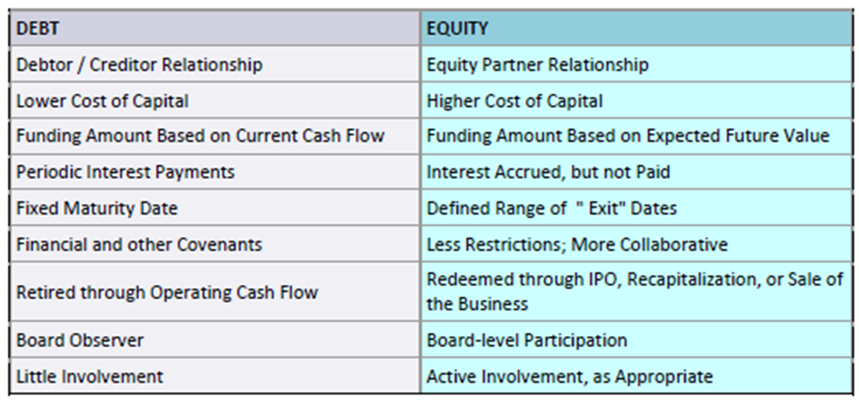
Equity vs. Debt: Assessing the Differences

Slide 56
READING + REFERENCES
“Securing Equity Capital To Create A Business Enterprise”
By Joshua Celeste
Duffy & Sweeney BLOG (October 2014)

Slide 57
Thank You!

Slide 58
QUESTIONS/COMMENTS

